Slide 1
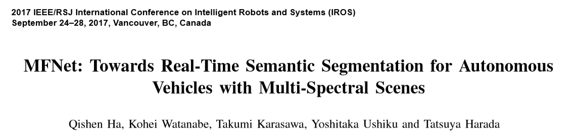
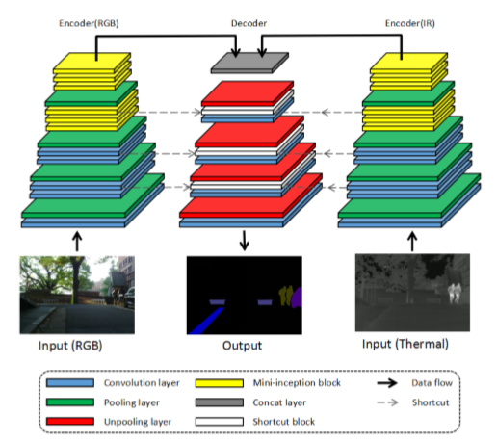

Slide 2
数据库A（200）
2019.4.13 MFNet
overall accuracy: 0.8700638623640494
| accuracy of each class: [0.52141346 0.81482613 0.11131059 0.29247595 0.87425106 0.77842764
0.69023353 0.94650424 0.74118105 0.80404505 0. 0.41133721
0. 0.00096154]
| class accuracy avg: 0.49735030626727145
| IoU: [0.00000000e+00 7.10569903e-01 1.52641686e-03 2.50092439e-01
8.73067453e-01 8.31101083e-01 7.65386333e-01 9.66199992e-01
6.96687091e-01 7.13191861e-01 0.00000000e+00 1.13691146e-02
0.00000000e+00 3.36813742e-04]
| class IoU avg: 0.4476560384687609

Slide 3
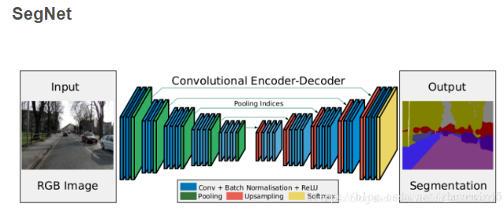

Slide 4
2019.4.14 SegNet rgb-ir4通道
overall accuracy: 0.792176917916052
| accuracy of each class: [0.3484382 0. 0. 0. 0.84728625 0.71097981
0. 0.90876426 0.37087376 0.72180561 0. 0.
0. 0. ]
| class accuracy avg: 0.2738238219852463
| IoU: [0. 0. 0. 0. 0.79844461 0.76555463
0. 0.9425729 0.3432679 0.59285742 0. 0.
0. 0. ]
| class IoU avg: 0.26482288152230066
2019.4.17 SegNet rgb-3通道
| overall accuracy: 0.677401891936683 | accuracy of each class: [0.33008278 0.68765043 0. 0.22232366 0.79012 0.51498824 0.63274503 0.92827062 0.76618304 0.41734336 0. 0. 0.32801849 0. ] | class accuracy avg: 0.40674175976480825 | IoU: [0. 0.60996824 0. 0.18321704 0.37937074 0.50699493 0.23090086 0.83797789 0.63921226 0.34267618 0. 0. 0.19031914 0. ] | class IoU avg: 0.3015874835639866

Slide 5
SegNet 全部shortcut连接，包括最大索引，没有Mini-Inception ( lr=0.01) 没有预训练
| overall accuracy: 0.7375862417052588
| accuracy of each class: [0.35459796 0.75787172 0.27324083 0.0327207 0.715511 0.68019053
0.23792415 0.92278334 0.46327331 0.50291403 0. 0.37008023
0.49330073 0.0016596 ]
| class accuracy avg: 0.4193438580045269
| IoU: [0.00000000e+00 5.98162061e-01 6.36382522e-02 3.01509485e-02
7.85481036e-01 6.09775614e-01 1.96867305e-01 8.83348328e-01
4.03506982e-01 4.32643984e-01 0.00000000e+00 1.35688826e-01
3.01153067e-01 7.05605645e-04]
| class IoU avg: 0.34162476990023577

